Slide 1

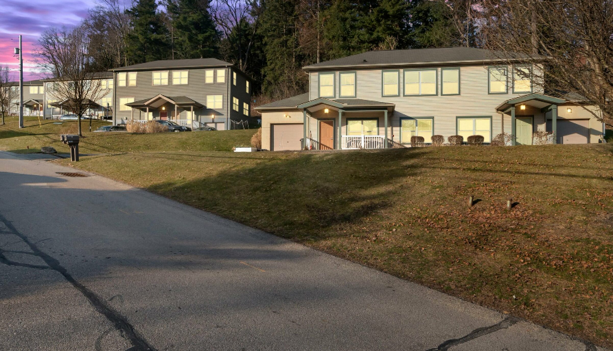
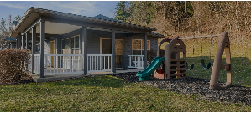
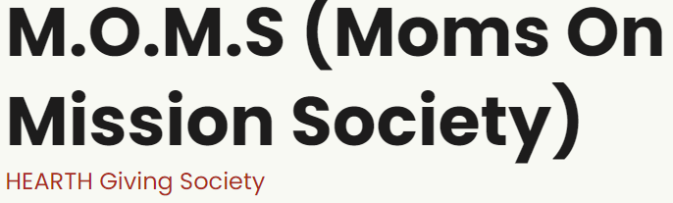

2025
HEARTH
“Homelessness Ends with Advocacy, Resources, Training and Housing”
3 Year Strategic Plan
2023
2024
2025

Slide 2

HEARTH’s Vision
The Hearth Board is a collaboration of thought leaders from diverse backgrounds committed to achieving our shared goals on preventing, supporting and safeguarding those who are survivors of domestic violence, trauma and homelessness, and ensuring access to services early and often to ensure we uplift and assist as many families as possible.
“Break the cycle of domestic abuse, trauma and homelessness for our Hearth families to become independent and economically self sufficient”
This strategy sits within a context where many organizations will be experiencing reduced funding.
We are committed to:
  Working together,
  Be accountability partners
  Being committed collaborators
  Being good stewards of all resources
Strategy Plan Key Components
Goals Grid that provides guidance for HEARTH board members to execute underlying task as a team
Provides guidance for workstream collaboration to Achieve, Preserve, Avoid and Eliminate key focus areas
Research external programs, financial resources, and staffing models to realize plan
Incorporate information gathered through best practices research and ongoing strategy sessions

Slide 3

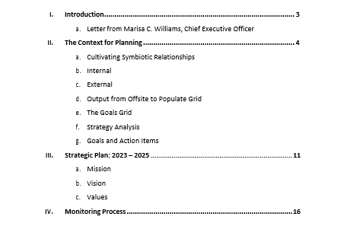
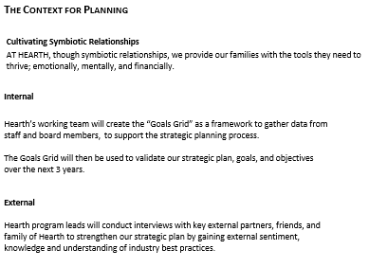
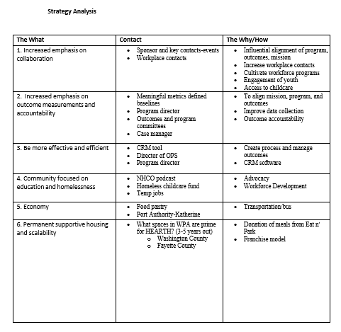
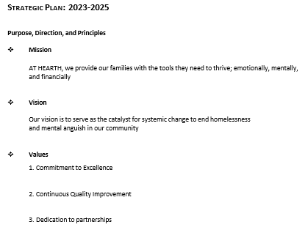
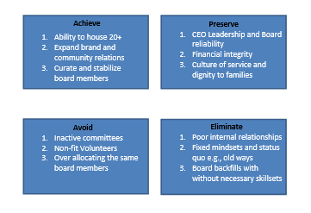
HEARTH’s Strategic Plan Overview
The Hearth Board is a collaboration of thought leaders from diverse backgrounds committed to achieving our shared goals on preventing, supporting and safeguarding those who are survivors of domestic violence, trauma and homelessness, and ensuring access to services early and often to ensure we uplift and assist as many families as possible.

