Slide 1



Board Orientation
Welcome to HEARTH

Slide 2






Board Orientation
Agenda
1) History of HEARTH
4) Board Roles & Responsibilities
2) Program Overview
5) Staff Operations
3) Overview of Funding Sources
6) Reference Materials

Slide 3
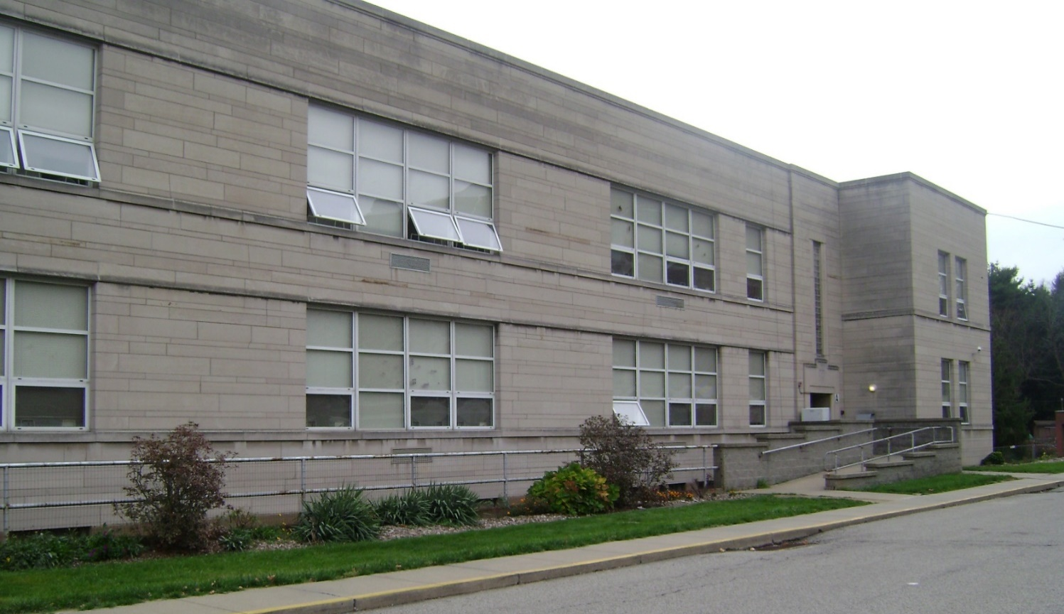
Board Orientation
History
It all started in 1987 when a group of service providers saw a need for housing.
In 1995, The Benedictine Place Transitional Housing Program opens.
North Hills Affordable Housing adds dba, HEARTH Homelessness Ends with Advocacy Resources Training and Housing.
In 1989, North Hills Affordable Housing officially formed.

Slide 4
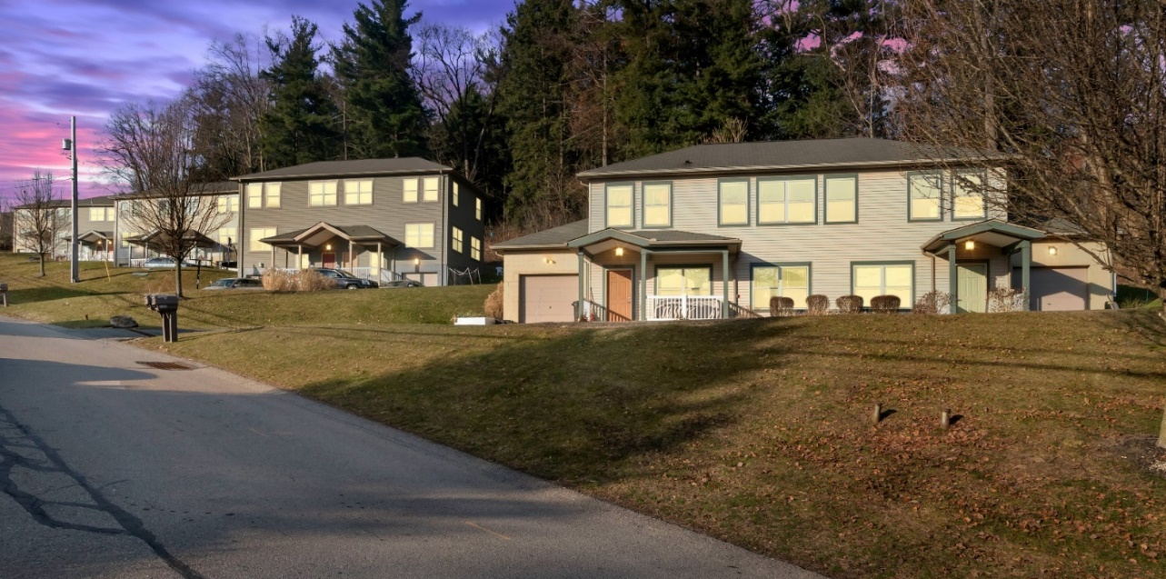
Board Orientation
Permanent Affordable Housing: Benet Woods
2004
Created a strategic plan to build permanent affordable housing.
ABOUT BENET WOODS:
  First permanent affordable housing in Northern Allegheny County
  11 townhomes and a community room
  Rent is below market rate; residents qualify by income
  Permanent Affordable Housing Committee and The Benet Woods Housing Corporation Board oversee the development
  PRIDE Program
  Permanent supportive housing program
  6 scattered site apartments in the community
  Funded by HUD; clients must have diagnosed disability
2007
Partnered with Trek Development to achieve this goal.
2009
Opened HEARTH at Benet Woods & PRIDE Program began.

Slide 5
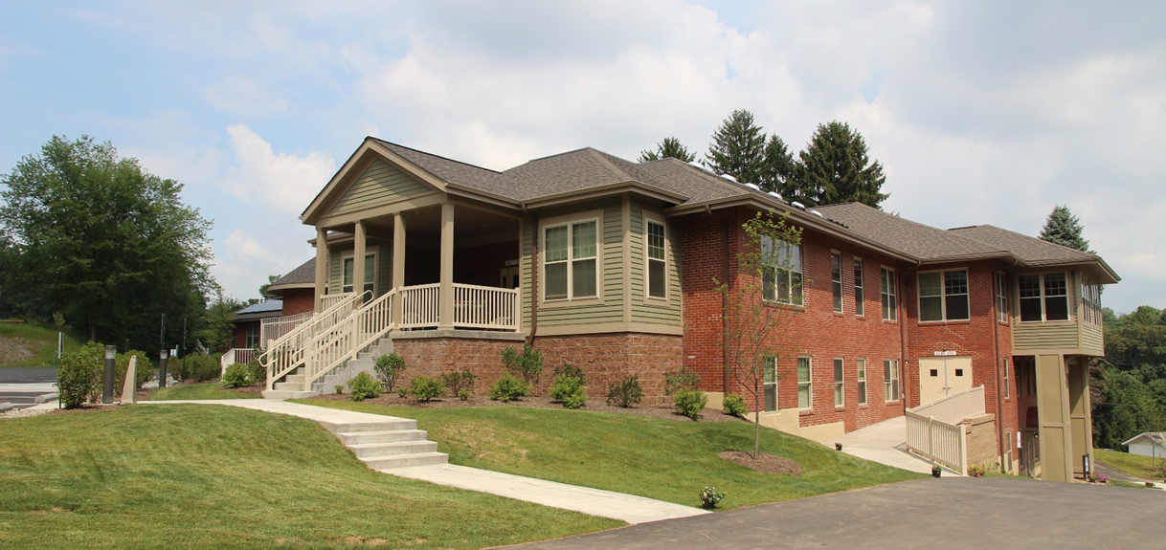
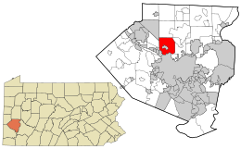
Board Orientation
Transitional Housing Challenges & Successes
2011
Left Benedictine Place in Ross Township.
2012
Partnered with Trek Development and renovated property in Shaler Township.
2013
Moved into new home!
2015
Allegheny County began coordinated entry & client referrals changed.
2016
Allegheny County DHS & Homeless Advisory Board decided to stop funding all transitional housing. HEARTH chose to maintain its mission and forge HUD funding.
2020
Celebrated 25 years of service.

Slide 6

Board Orientation
Our Families
OF OUR CURRENT HEARTH PROGRAM PARTICIPANTS:
  8 children are enrolled in childcare, seven of which are enrolled in the on-site Early Head Start classroom
  4 Families receive TANF
  90% receive SNAP benefits
  100% of the families are on Medicaid
  11% of the parents receive child support
  38% of the moms are enrolled in an educational program
  63 % of the moms are employed
  12% are working while enrolled in school
  14 parents identify as women; 1 parent identifies with male pronouns; 1 is gender non-conforming
1,049+
31
Individuals
Served
Average Age
Of Parent
9
2
Average Age
Of A Child
Average Number Of Children Per Mom

Slide 7
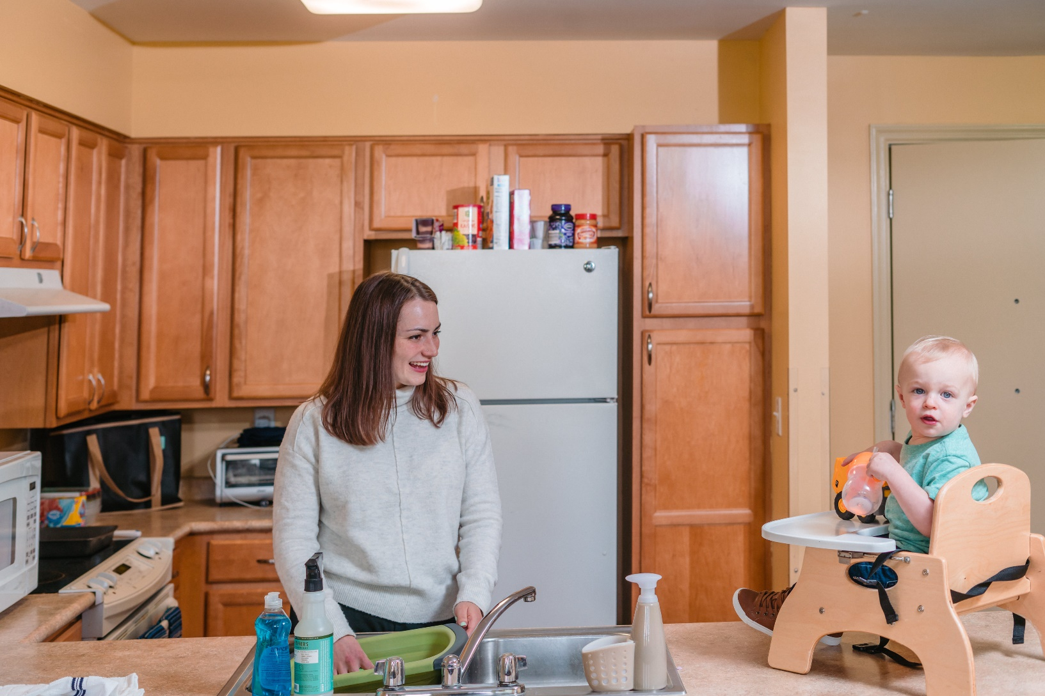
Board Orientation
Our Families: Program Participant Outcomes
59%
59%
Increased Their Income Level
Increased Their Education Level
64%
79%
Obtained Employment
Obtained
Housing
*Based on returned surveys from past program participants as of 2022

Slide 8

Board Orientation
Glossary of Terms
THERE ARE A WIDE VARIETY OF ASSISTANCE PROGRAMS AVAILABLE FOR HEARTH’S FAMILIES:
TANF – Temporary Assistance for Needy Families
SNAP – Supplemental Nutrition Assistance Program
WIC – Women, Infants and Children Special Supplemental Nutrition
Housing Choice Voucher (Section 8)

Slide 9
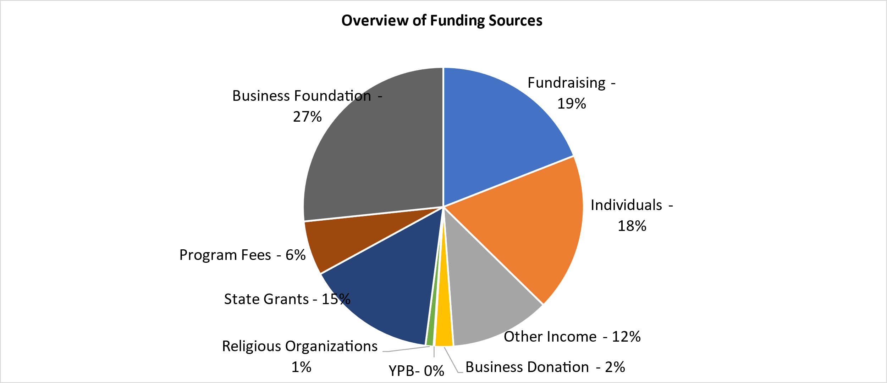
Board Orientation
Overview of Funding Sources

Slide 10
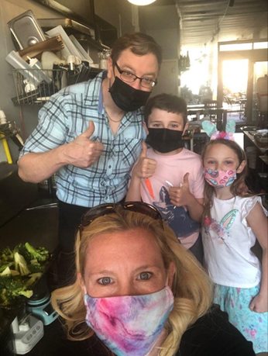




Board Orientation
Get Involved
Fundraising
  Virtual Fundraiser
  Safe Place Partner
  Workplace Matching Gifts
  United Way
In-Kind Donations
  Host an in-kind drive
  Check-out HEARTH’s Amazon Wishlist or Target registry
  Select HEARTH as your charity of choice on Amazon Smile
Special Events
  Tees &Traps
  HEARTH’s Art of Wine & Food
  Purses with a Purpose
Communications
  Follow and share on social
  IG/FB/Linkedin- @HEARTHPGH
Volunteering
Board Member, Kim Buchheit and her family preparing holiday meals for our families.

Slide 11
Board Orientation
Board Roles and Responsibilities
Determine the organization’s mission and vision.
Maintain legal and ethical integrity and accountability.
1
5
2
Hire the CEO.
6
Recruit new board members, donors and supporters.
3
Provide governance for the organization.
7
Serve as an ambassador for the organization.
Fundraising and “Friendraising.”
Actively participate in one of the four standing committees (Finance, Personnel, Board Development, and Program)
4
8
*Source: Get Fully Funded.

Slide 12
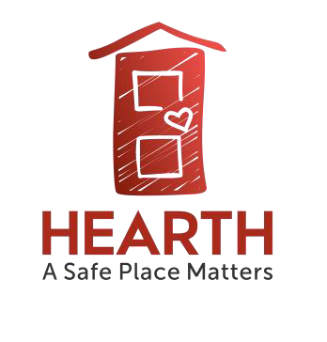
Board Orientation
Organizational Chart
2022
Board Of Directors
Board President
Chief Executive Officer
Marisa C. Williams
Volunteer and Administrative Coordinator
Harriet Riley
Finance Director
Delia Barnett
Program Director
Pam Lindenberger
Development Director
Vacant
Program Outreach Coordinator
Jenny Shahinian
Development Associate
Megan Lang
Facilities Manager
Curt Ford
Night-Time Supervisor
Janet Wade
Program Career Coach
Tyniesha Eaddy

Slide 13
Board Orientation
Reference Documents
Board Member Job Description and Expectations
HEARTH By-laws
Summary Committee Descriptions
Assistance Programs Available to Program Participants

