Slide 1



SOCIAL MEDIA REPORT
JULY 2021

Slide 2
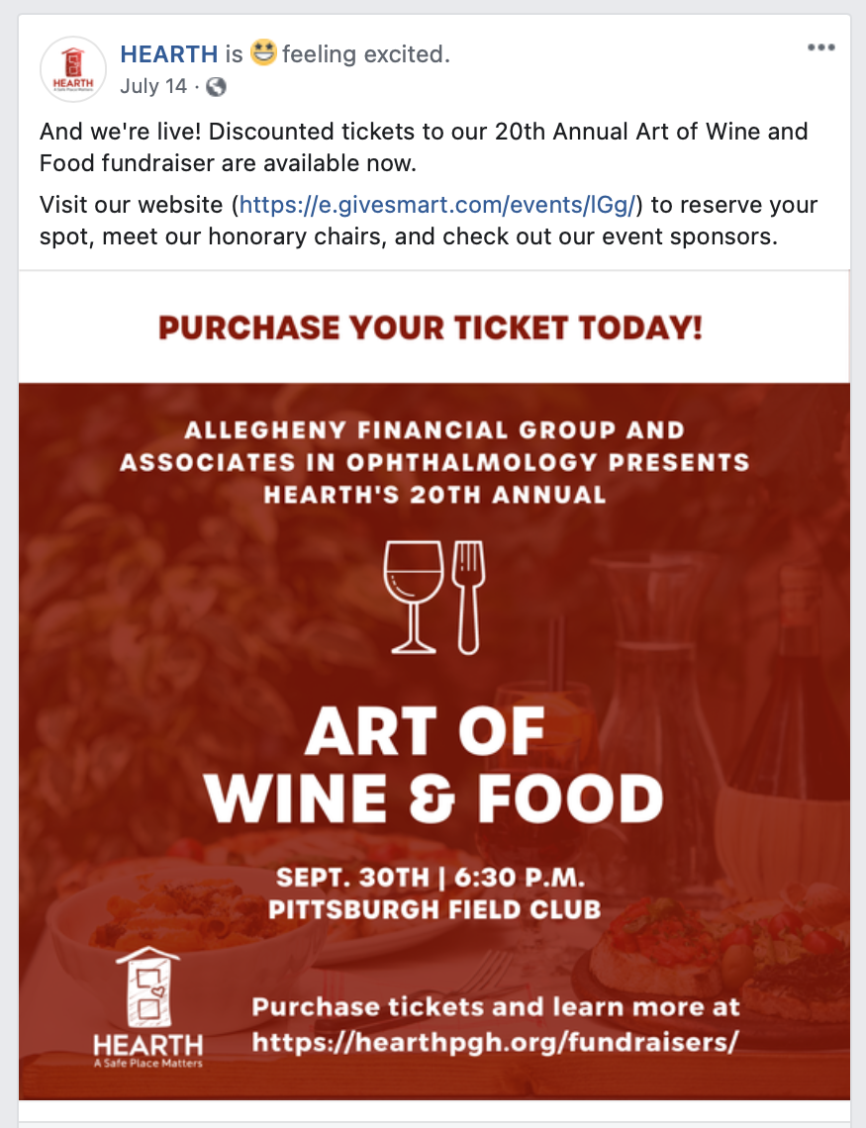
Facebook Posts
Top Performing Post
MoM Analytics
7 New Page Likes
Increase of 44% from June 2021
10 posts
in July
Decrease of 33% from June 2021
3.9% avg. engagement rate
Decrease of 64% from June 2021
Insight & Recommendations
Insight: Changing the profile picture for PRIDE month led to an increase in June engagement
  Recommendation: Consider changing the profile picture more frequently (i.e., use event logos or "cause" colors)
Insight: June posts included live/recap event pictures. July did not.
  Recommendation: Continue to monitor throughout the fall. If the trend remains steady, explore social campaigns for non-event months
Insight: HEARTH relies heavily on event pages
  Recommendation: Determine an advertising budget ($75 - $200) to boost the page's reach

Slide 3
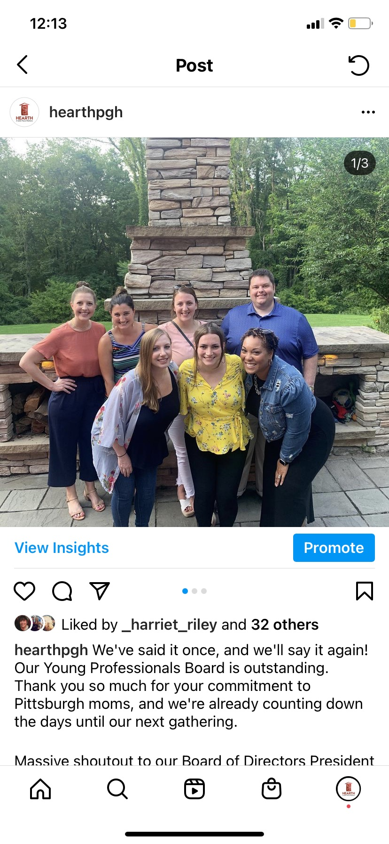
Instagram Posts
Analytics
Top Performing Post
783 total followers
11 more followers compared to June 2021
9 posts
in July
Decrease of 18% from June 2021
495 accounts reached
Decrease of 5% from June 2021
Insights & Recommendations
Insight: Wine & Food stories are not performing well.
  Recommendation: Rethink design and layout to include less text
Insight: Highlight stories on page are out of date
  Recommendation: Delete the old and add new

Slide 4
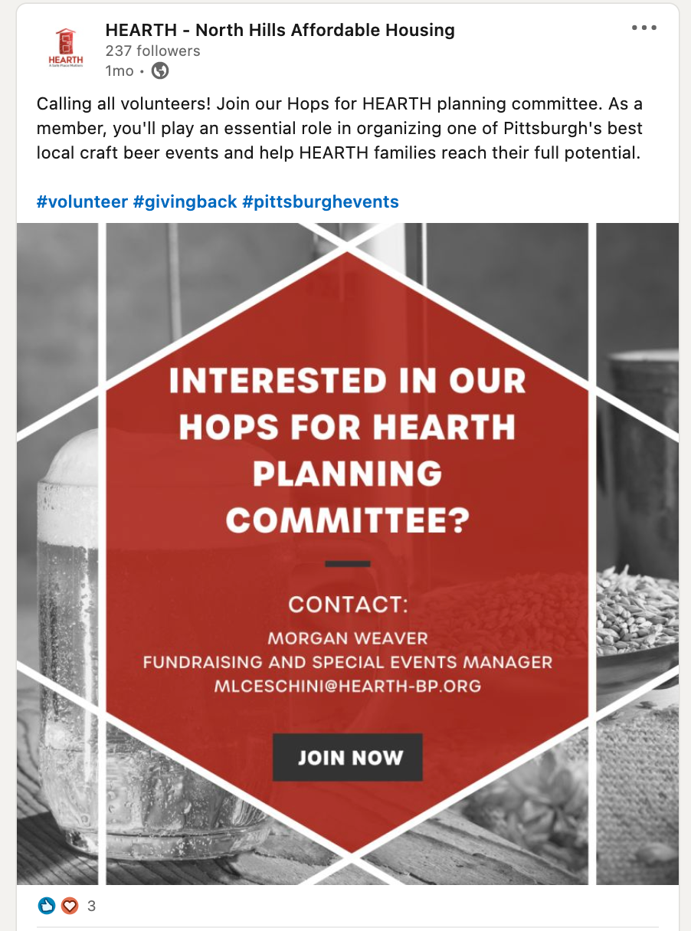
LinkedIn
Analytics
Top Performing Post
8 New Page Likes
Increase of 33% (6) from June 2021
6 posts
in July
Increase of 100% from
June 2021
5.63% avg. engagement rate
Decrease of of 29% from June 2021
Insights & Recommendations
Insight: LinkedIn added a new event feature
  Recommendation: Explore for promoting HEARTH events and sponsors
Insight: Professional success and highlight stories perform well on LinkedIn
  Recommendation: Celebrate work anniversaries and feature board members

Slide 5
Email Newsletters
June
July
Subject line:
New Look. Same Mission. Same Commitment.
Open rate: 16.99%
Click rate: 1.35%
Unsubscribe rate: 0.7%
Subject line:
Finding A Secure, Positive Environment at HEARTH
Open rate: 14.5%
Click rate: 1.59%
Unsubscribe rate: 1.4%
Insight: More data might be available to inform event sales and fundraising efforts
  Recommendation: Connect with Megan to learn more about Salsa and reporting capabilities

